Slide 1
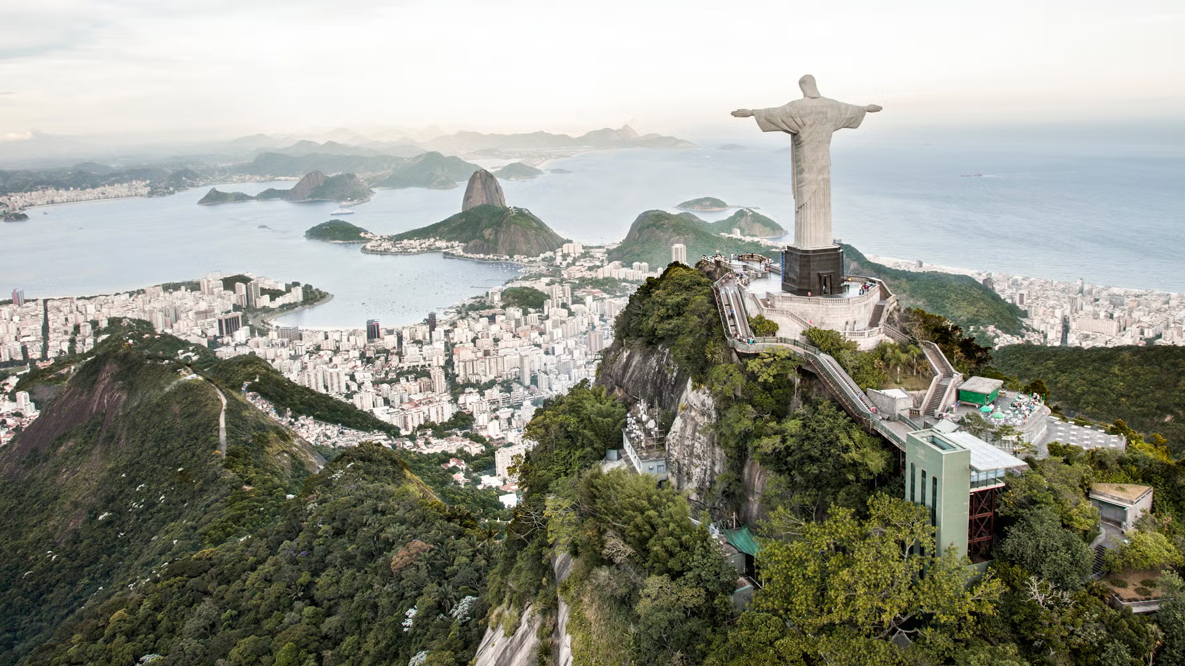
✅ Magist: good fit to expand to Brazil
Asli
Carlos
Sahand

Slide 2
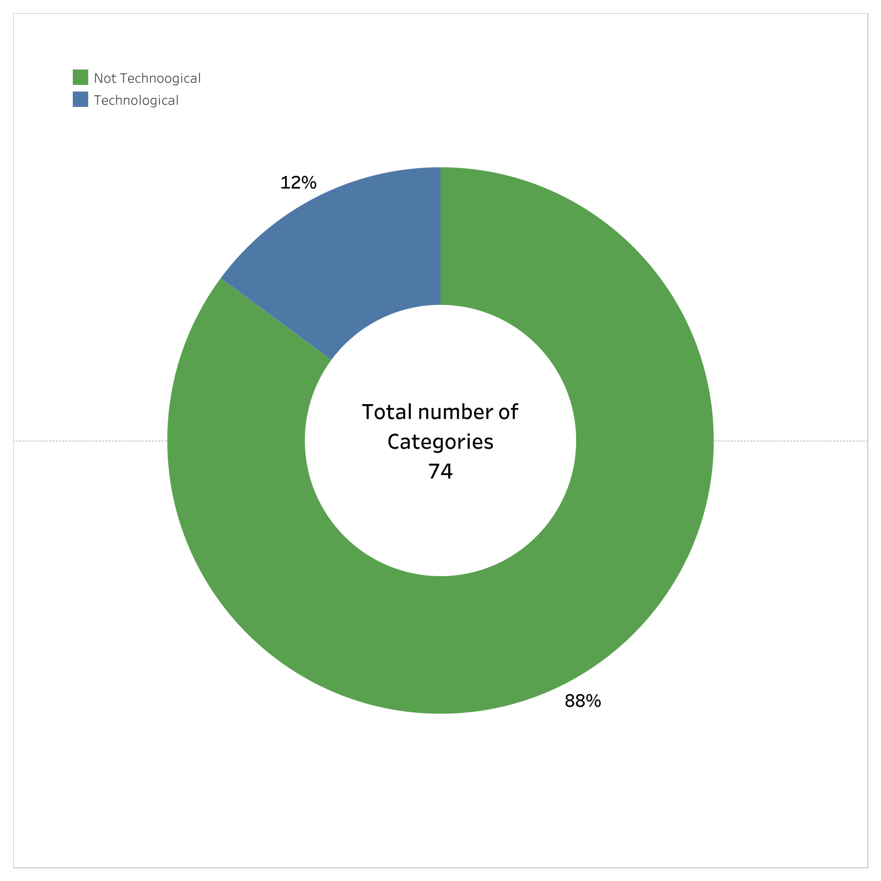
74 Categories. 11 Categories are Technology- related
Technology-related categories make up only 12% of all categories offered by Magist

Slide 3
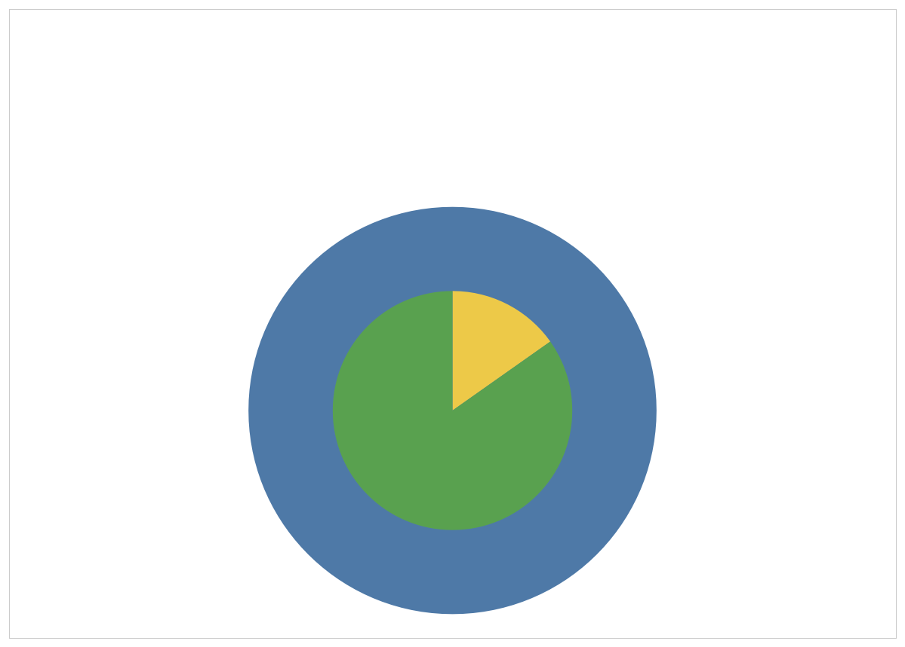
Low Revenue on Technological Categories!
Eniac Revenue 14 M
Magist Revenue 8.2 M
Magist Revenue only for Technological Products 1.3 M
Revenues between April 2017 to March 2018

Slide 4
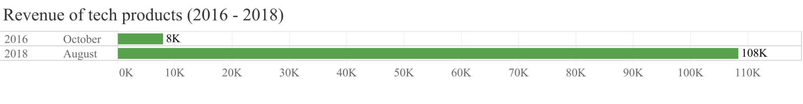
Growth of tech orders and revenue
Strong internal strategy or product-market fit.
Significant market share within a short time.
Number of tech orders increased ≈ 2000%
🛒💻📦🔌
Revenue increased 100K euros
Potential better pricing, installment plan, or higher-end tech products.
💳💰 💵🏦

Slide 5
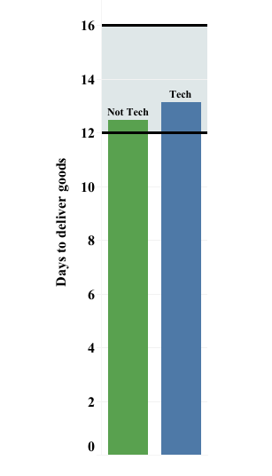
Acceptable performance on delivery
Magist has delivered 97% of all the orders.
Brazil National Average
According to Magist estimated delivery time, 7% of orders been delayed.
But Regardless to Estimated time, The average delivery time from Magist aligns with the Brazil national average.
Source : Folha de S.Paulo
Notes:
We think magist is doing good job with deliveries, here is why.
-Magist delivered good percentage of goods regardless of being delayed or not.
-with their own estimated delivery time only 7% of orders have been delivered later than promised date.
-but we cant rely on their estimation, so we had to look for the average delivery time in brazil to compare with magists performance. We can see delivery time remain in range.

Slide 6
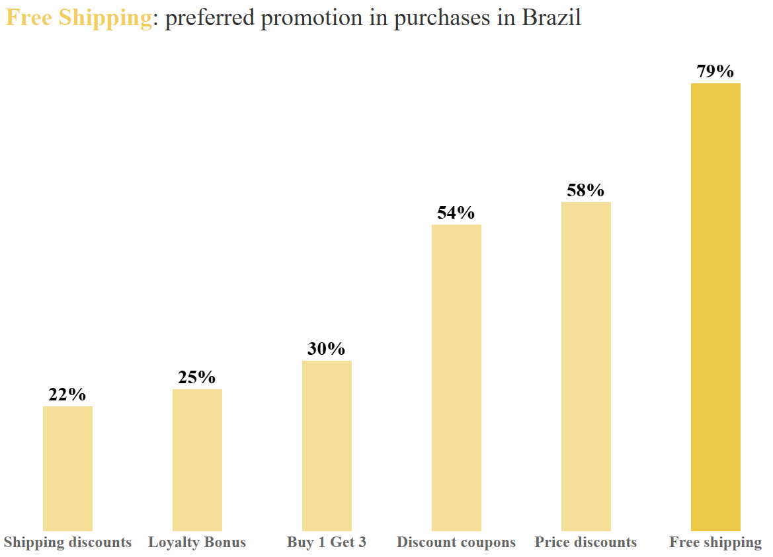

Shipping Rate
On average, the shipping cost is 6.3€/KG.
With our product portfolio, we can expect 1% to 1.5% shipping cost Based on our product price and package size.
Free Shipping Promotion would be a cost-efficient strategy for launching our products.
Source : Americas Market Intelligence
Notes:
We estimated that Magist is charging 6.3 euro per kg, ofcourse most of the goods that magist is shipping are heavier in Dimensional weight than gross weight.
Considering our products packaging and pricing, we can expect around 1% shipping cost. Acceptable term for shipping cost in supply chain is between 5% to 20% of the product price. So this is an advantage for us.
We have looked for potential promotions that consumers in Brazil are preferring. So based on this survey 79% of online shoppers, prefer Free shipping promotion.
So based on our findings and research, we strongly suggest free shipping promotion to launch our operations in brazil. Because it is the best cost-effective solution.

Slide 7
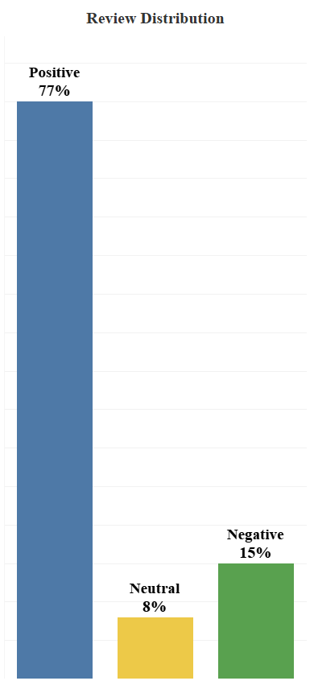
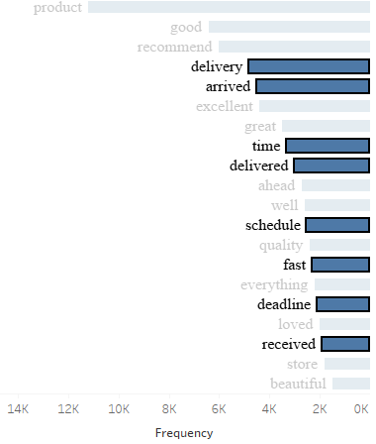
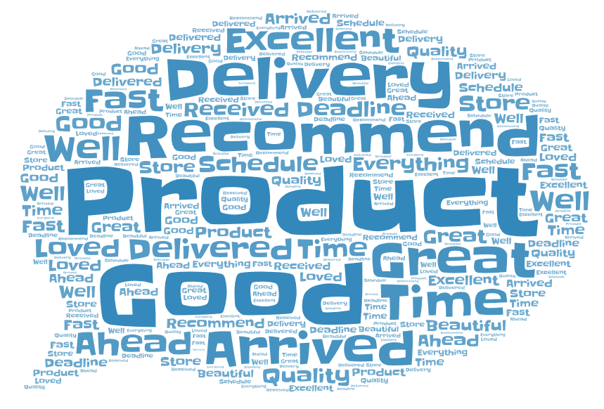
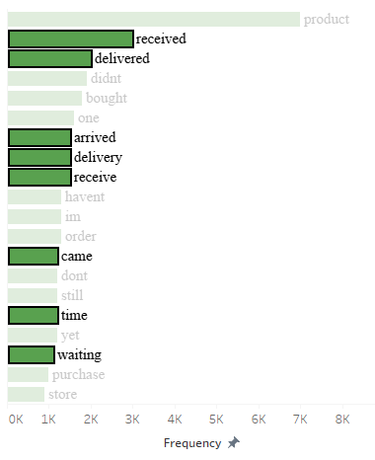
Reviews
We have analyzed reviews based on score and comments.
Notes:
We think feedback from customers reveals the true nature of the operations. So we have analyzed reviews based on score and comments from the customers.
With considering comments and scores we made 3 group for reviews. The term we were looking was about deliveries since Magist is only our potential supply chain solution partner and we don't want to evaluate other sellers through Magist software.
We are satisfied with the results as you can see.

Slide 8

Conclusion
Magist handles tech well — not dominant, but a profitable niche. Potential to grow with a dedicated brand like Eniac.
Strong logistics fulfillment — promising for premium products, which must arrive reliably.
Magist is gaining traction — suggesting strong marketplace demand and adoption in Brazil.
Notes:
Considering actual growth and potential, shipping rates and performance, customers feedback, we think magist good step in brazil.
I am sure our next presentation will be about possible location to establish our warehouse. :)

